Slide 1
80949AE: Introduction in Microsoft Dynamics NAV 2017
Koen Stox
December 2016

Slide 2
Course Overview
Module 1: Microsoft Dynamics NAV as an ERP System?
Module 2: Multiple Client Support
Module 3: Browse Application Areas
Module 4: User Interface
Module 5: User Personalization
Module 6: Basic Functionalities
Module 7: Master Data for the Sales and Purchase Process
Module 8: Process Sales and Purchases
Module 9: Technology Overview
Notes:
Welcome to Introduction in Microsoft Dynamics NAV 2016
After welcoming the audience and introducing yourself, provide an overview of the course modules.
You might want to emphasize the following:
This course an introduction to Microsoft Dynamics NAV
This is the perfect course to prepare students for other courses on Microsoft Dynamics NAV

Slide 3
Module 1
What makes Microsoft Dynamics NAV an ERP System?

Slide 4

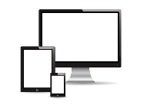
ERP System
Customer data: name, address, payment terms, …
Sales order
Sales Rep
Customer payment
Bookkeeper
Sales shipment
Warehouse worker
Notes:
The purpose of this module is:
To check if the audience has any experience with what an ERP system is
To explain the main features of an ERP system and why Microsoft Dynamics NAV is an ERP system
This module is perfect to start a class discussion and to get the training going.
Ask the audience what an ERP system is
Why is Dynamics NAV an ERP system
Explain the concept of island systems, and proceed to the next slide.

Slide 5

Common Database
Manufacturing
Sales & Marketing
Warehouse Management
Purchases
Financial Management
Human Resources
HR manager
Sales Rep
Bookkeeper
Warehouse worker
Notes:
This diagram can be used to explain the concept of a central database and integrated application areas.
This is one of the main features of an ERP system.
After showing this slide, you can quickly show a couple of application areas in NAV.
Als mention that you will browse the different application areas in the following module.

Slide 6
ERP System
Real time
Support growth
Job roles and authorization
Notes:
Use this diagram to explain that:
Transactions in an ERP systems are at real time, for example the posting of a sales order that creates G/L entries in financial management
Microsoft Dynamics NAV can support grow when companies expand their business
Microsoft Dynamics NAV contains a security system and role tailored interface based on a number of job roles. You might want to show the Order Processr role center.

Slide 7
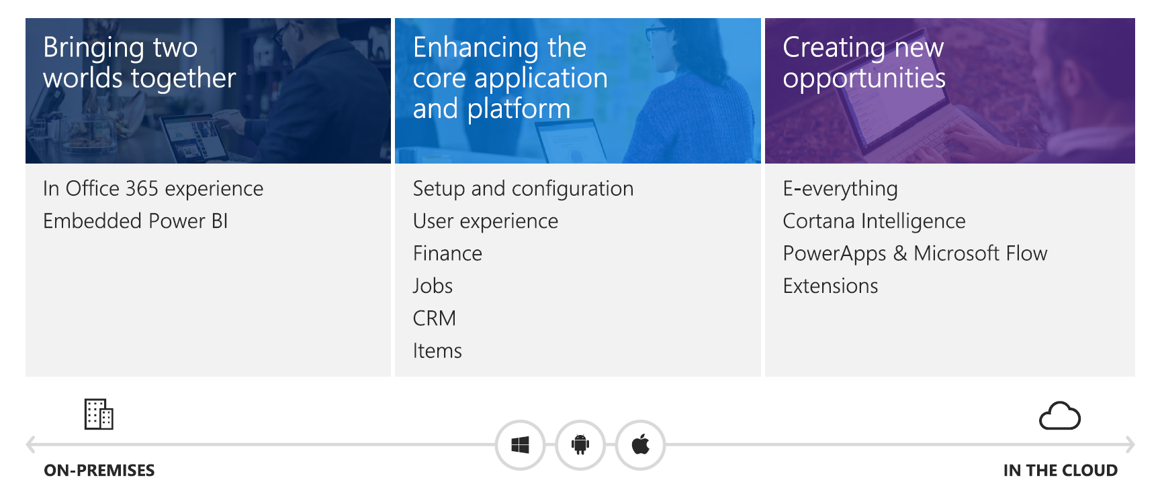
Microsoft Dynamics NAV 2017

Slide 8
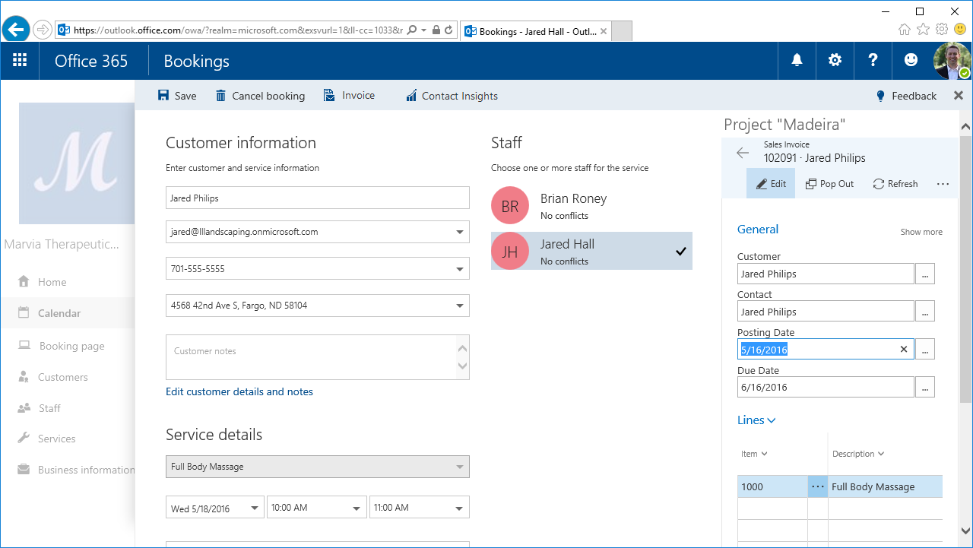
In Office 365 Experience
Manage business interactions in Outlook
Invoice from Microsoft Booking appointments
Create a data connection
Notes:
If your organization uses Office 365, Dynamics NAV 2017 includes an add-in so you can invoice your customers based on entries in your Outlook calendar. From a calendar appointment, you can open the Dynamics NAV add-in and get an overview for the customer associated with the appointment. Then, you can create and send an invoice for the services provided in the meeting – all of this happening right there in the Outlook calendar. You can work directly with attachments to the associated email. We’ve also made it easy to update the add-in – you’ll get notified that a new version is ready for you in Outlook.
The add-in works for attachments in mail as well – you can send the email attachments directly to the Incoming Documents list and send the documents, such as PDF files, to an Optical Characters Recognition (OCR) service. Here the documents are turned into a machine-readable format so that the invoice information can be added automatically to Dynamics NAV – this reduces the risk of errors and as a result increases productivity.
From the Contacts List in Dynamics NAV, you can manually synchronize your Dynamics NAV contacts to Office 365 People. The contacts from Office 365 will sync back to Dynamics NAV as well. There is a filter that can be applied to the synchronization process so users will only need to sync the contacts they use most often. This same filter is used during the automatic background sync as well. This synchronization process also works with Microsoft Outlook on the desktop

Slide 9
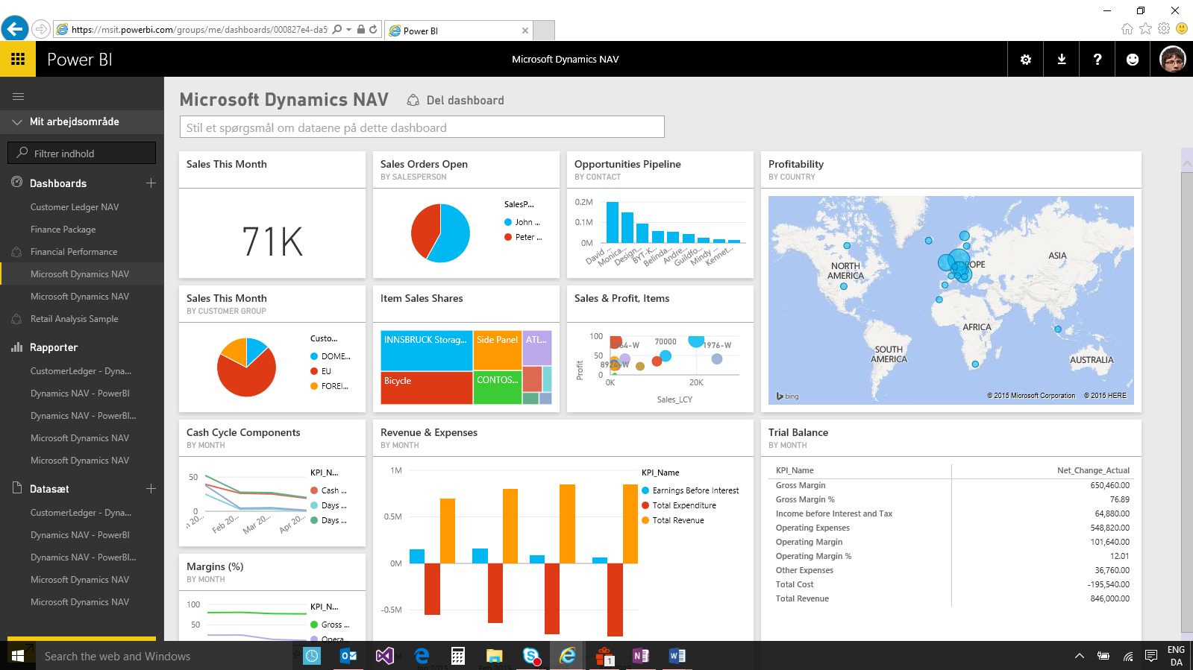
Embedded Power BI
Notes:
You can use embedded Power BI to easily create insightful charts and reports using Power BI, and make them available within your Dynamics NAV 2017 Role Center.
Leverage the Dynamics NAV 2017 Power BI Content Pack to get started, and utilize existing Power BI security to manage reports.
Get started quickly by using the Dynamics NAV content pack. The content pack provides samples reports that you can use in both the demo or production environment. You can also make edits to the content pack that we provide.
Any report that is created in Power BI may be made visible on the Dynamics NAV 2017 Role Centers. This enables users to get the information they need to perform their job right from within their Role Center.

Slide 10
Module 2
Multiple Client Support

Slide 11
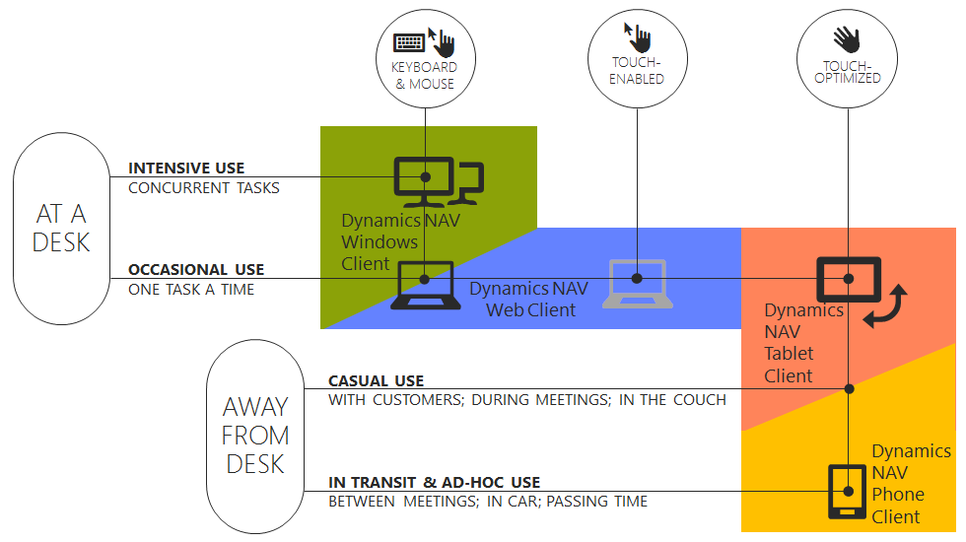
Module 2 - Overview
Windows Client
Web Client
Phone Client
Tablet Client
Outlook Client
Notes:
Before starting to explore Microsoft Dynamics NAV, in this module you will give a short introduction of all the different application areas.
The purpose is to give the audience an idea what NAV can be used for.
You can of course not cover every module in detail. You could however refer to other courses that cover these topics more in detail.

Slide 12
Windows Client
RoleTailored
Intuitive and versatile
Notes:
You can use this slide to show the structure of the ribbon.
Also refer to other Microsoft applications (such as Office) that also use ribbons.

Slide 13
Web Client
View and edit NAV data over the internet
Any web browser
Interface similar to the NAV Windows client
Notes:
You can use this slide to show the structure of the ribbon.
Also refer to other Microsoft applications (such as Office) that also use ribbons.

Slide 14
Tablet and Phone Client
Access data from a table or a phone
Portability and flexibility
Windows, iOS, Android
Notes:
You can use this slide to show the structure of the ribbon.
Also refer to other Microsoft applications (such as Office) that also use ribbons.

Slide 15
Outlook Client
Synchronize contacts
Manage business interactions in Outlook
Invoice from Microsoft Booking appointments
Notes:
You can use this slide to show the structure of the ribbon.
Also refer to other Microsoft applications (such as Office) that also use ribbons.

Slide 16
Module 3
Browse Application Areas

Slide 17
Module 3 - Overview
Finance
Business Intelligence
Marketing & Sales
Design and Engineering
Operations Planning
Purchasing
Shipping and Receiving
Warehouse Activities
Service
Resource Planning
Project Management
Human Resources
Notes:
Before starting to explore Microsoft Dynamics NAV, in this module you will give a short introduction of all the different application areas.
The purpose is to give the audience an idea what NAV can be used for.
You can of course not cover every module in detail. You could however refer to other courses that cover these topics more in detail.

Slide 18
Module 3 - Review
Finance
Business Intelligence
Marketing & Sales
Design and Engineering
Operations Planning
Purchasing
Shipping and Receiving
Warehouse Activities
Service
Resource Planning
Project Management
Human Resources
Notes:
Before starting to explore Microsoft Dynamics NAV, in this module you will give a short introduction of all the different application areas.
The purpose is to give the audience an idea what NAV can be used for.
You can of course not cover every module in detail. You could however refer to other courses that cover these topics more in detail.

Slide 19
Module 4
User Interface

Slide 20
User Interface - Overview
The Window Client and Web Client Interface.
The Application Menu
My Settings
The Ribbon
The Navigation pane.
The List page.
The Card page.
Explore the Role Center.
Notes:
The purpose of this module is to familiarize the audience with the NAV user interface.
You can cover the different components starting at the top, and then move down to the bottom of the window (the status bar).
Try to limit details on personalization, because this is covered in the following module.

Slide 21
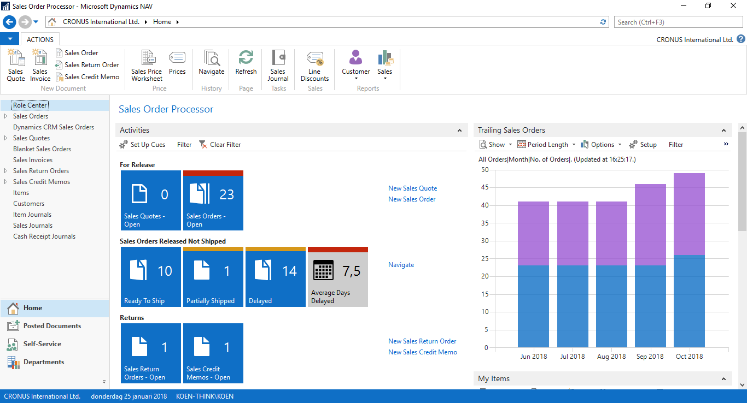
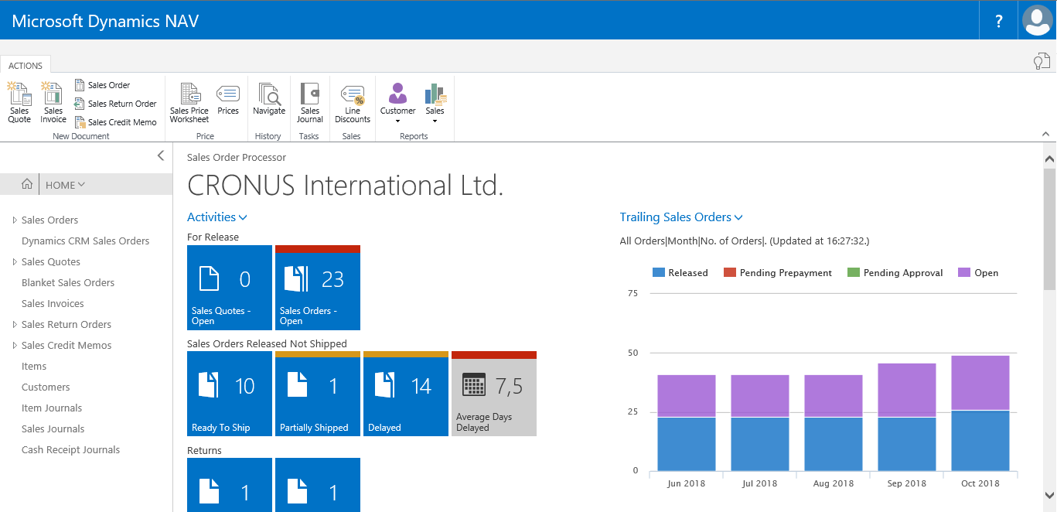
The Windows Client and Web Client Interface
Notes:
You can use this slide to show the structure of the ribbon.
Also refer to other Microsoft applications (such as Office) that also use ribbons.

Slide 22
The Application Menu
Only in Windows Client
Change:
Work Date
Language
Server
Company
Customize
Help
Notes:
You can use this slide to show the structure of the ribbon.
Also refer to other Microsoft applications (such as Office) that also use ribbons.

Slide 23
My Settings
Only in Web Client
Change:
Role Center
Company
Work Date
Region
Language
Time Zone
My Notifications
Notes:
You can use this slide to show the structure of the ribbon.
Also refer to other Microsoft applications (such as Office) that also use ribbons.

Slide 24
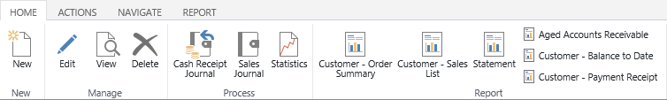
The Ribbon
Structure
Tabs
Groups
Actions
Tab
Action
Group
Notes:
You can use this slide to show the structure of the ribbon.
Also refer to other Microsoft applications (such as Office) that also use ribbons.

Slide 25
The Navigation Pane
 | Windows client | Web client
Home menu | ✓ | ✓
Additional menus | ✓ | ✓
Departments menu | ✓
Notes:
You can use this slide to show the structure of the ribbon.
Also refer to other Microsoft applications (such as Office) that also use ribbons.

Slide 26
Pages
Card | Worksheet
List | Confirmation dialog
Role Center | List plus
Card part | Navigate page (wizard)
List part | Standard dialog
Document
Notes:
Use this slide to show the different page types, but also emphasize that you will cover the 2 most used types in detail:
Card
List

Slide 27
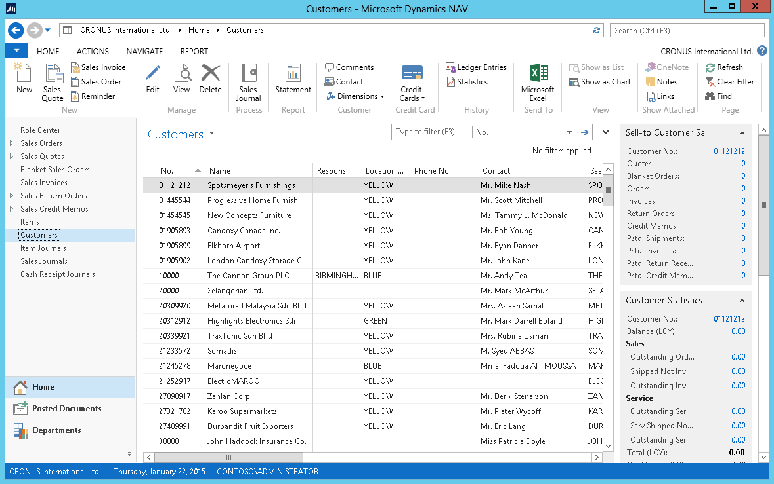
Pages
List Page Windows Client
Ribbon
Filter pane
List
FactBox pane
1
2
4
3
Notes:
After showing this slide and explaining the different components of a list page, go to the application and show some examples of list pages.
Remember to only focus on the interface. Topics such as personalization, filter, search, … are covered in other modules.

Slide 28
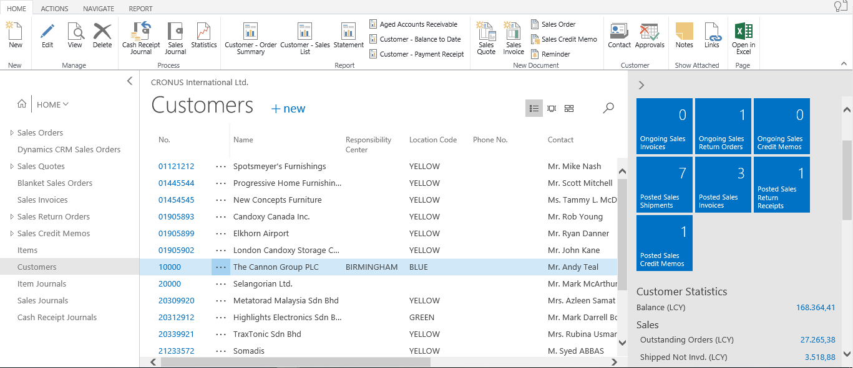
Pages
List Page Web Client
Ribbon
Display & Search
List
FactBox pane
1
2
4
3
Notes:
After showing this slide and explaining the different components of a list page, go to the application and show some examples of list pages.
Remember to only focus on the interface. Topics such as personalization, filter, search, … are covered in other modules.

Slide 29
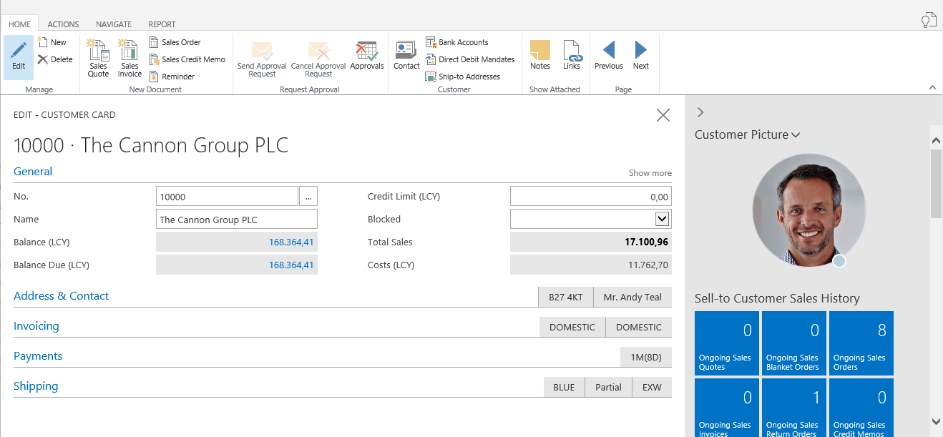
Pages
Card Page
Ribbon
Expanded FastTab
Collapsed FastTab
FactBox pane
1
2
4
3
Notes:
After showing this slide and explaining the different components of a card page, go to the application and show some examples of card pages.

Slide 30
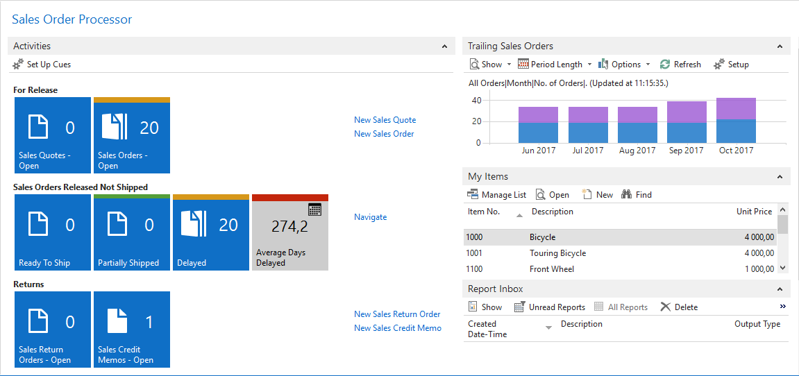
The Role Center
Central point for all information and actions.
Role center parts:
Activities
Charts
My Notifications
Lists
Online information
My Job Queue
Report Inbox
Notes:
Because role centers are very important in NAV, make sure that everyone understands the concept of a role center.
Provide some examples of role centers that can be used in NAV.
Changing the role center is covered in another module.

Slide 31
Module 5
User Personalization

Slide 32
User Personalization - Overview
Personalization and Configuration
Customize the Ribbon
Customize the Navigation Pane
Customize This Page
Customize a FactBox
Customize a FastTab
Customize a Chart
Customize Parts on the Role Center Page
Cues
Change the Profile and Role Center
Notes:
Now that everyone is more familiar with the user interface, you can start with personalization.
In the module overview, you can explain that personalization is the process of showing and hiding interface components.
An example that everyone will recognize is the one of showing and hiding columns in a list.

Slide 33


Personalization and Configuration
Personalization
Configuration
Susan
Sales Order
Processor
Notes:
It’s important that the audience knows the difference between personalization and configuration.
As an example, you can open NAV in configuration mode.

Slide 34
Personalizing the Windows Client and the Web Client
Windows client:
Full personalization
Personalize all components
Impacts Windows and Web client
Web client:
Limited personalization
Choose/hide columns
Personalize through Windows client
Notes:
Because Customize this Page groups most op the personalization options of a page, this is good place to start from.
However, also explain that by right-clicking on an interface component, you can also start personalizing.

Slide 35
Customize This Page
Display options
Choose columns
FastTabs
FactBoxes
Ribbon
Notes:
Because Customize this Page groups most op the personalization options of a page, this is good place to start from.
However, also explain that by right-clicking on an interface component, you can also start personalizing.

Slide 36
Customize a FastTab
Which fields are shown in a FastTab
Importance:
Standard
Promoted
Additional
Quick Entry
Notes:
Customizing a FastTab could be very interesting.
Explain the risk of removing (mandatory) fields. That’s why:
Customizing a FastTab should be done by someone who has enough knowledge of NAV
Instead of removing fields, it’s better to make them additional

Slide 37
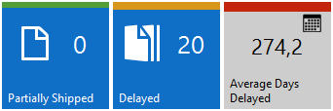
Cues
Visual representation of aggregated business data
Role Center pages
Click-through
Colored indicators
Notes:
To show this function, make some examples together with the audience.
Important to mention:
Cues can be personalized
Cues can modified on company level

Slide 38
Module 6
Basic Functionalities

Slide 39
Basic Functionalities - Overview
Enter and edit information.
Use zoom, reports, sorting, search, filters, ad navigation functions.
Integrate with other Microsoft Office products, such as OneNote, Word, and Excel.
Print reports and documents.
Notes:
This is an important module because it covers basic functionalities that everyone working with NAV should master.
It’s also an important preparation for the following modules in which we start working with NAV data.
Make sure that you cover all topics, also the ones that don’t have a specific slide in this presentation.

Slide 40
Edit and Enter Information
Date fields - only accept date parameters.
Number fields - only accept numbers.
Text fields - accept information in any format.
Code fields – only accept predefined codes.
FlowFields – display amounts and quantities calculated by Microsoft Dynamics NAV.
Notes:
After showing this overview of the different field types, you might want to demonstrate the following:
Shortcuts for dates in date fields
Calculations in number fields
DrillDown of FlowFields

Slide 41
Edit and Enter Information – Enter Dates
User Input | Result
w | Work date entered in Tools>Work Date
t | Today's date
# | Number of the day in the current work month
Month-day-year | 122515, 12 25 15, 12-25-15, 12/25/15
Weekday-week number-year | Fr5215, fr 52 15 fr-52-15, fr/52/15
Notes:
You can use this table to show the shortcuts that can be used in date fields.

Slide 42
Making Notes and Comments
 | Windows client | Web client
Notes | ✓ | ✓
Sending notes | ✓
Editing notes |  | ✓
Comments | ✓ | ✓
Links | ✓ | ✓
OneNote notes | ✓
Notes:
Although there is only one general slide, the Search and Filter functions are very important.
Show these functions by demonstrating all features.
Encourage the audience to follow on their computers.
Make sure you also cover:
Filter criteria
Save View as…

Slide 43
Search Information
 | Windows client | Web client
Search in lists | ✓ | ✓
Search in cards | ✓
Quick filter | ✓ | ✓
Advanced filter visible fields | ✓ | ✓
Advanced filter non-visible fields | ✓
Limit totals | ✓
Filter criteria | ✓ | ✓
Save view as… | ✓
Notes:
Although there is only one general slide, the Search and Filter functions are very important.
Show these functions by demonstrating all features.
Encourage the audience to follow on their computers.
Make sure you also cover:
Filter criteria
Save View as…

Slide 44
Basic Functionalities - Review
Enter and edit information.
Use zoom, reports, sorting, search, filters, and navigation functions.
Integrate with other Microsoft Office products, such as OneNote, Word, and Excel.
Print reports and documents

Slide 45
Module 7
Master Data for the Sales and Purchase Process

Slide 46
Master Data for the Sales and Purchase Process - Overview
G/L Account Cards
Chart of Accounts Page
Customer Cards
Vendor Cards
Item Cards
Notes:
This module is the preparation of the following one on sales and purchase processes.
These processes use the master data that is covered in this module.
Give the audience the time to practice the creation of new master data.

Slide 47
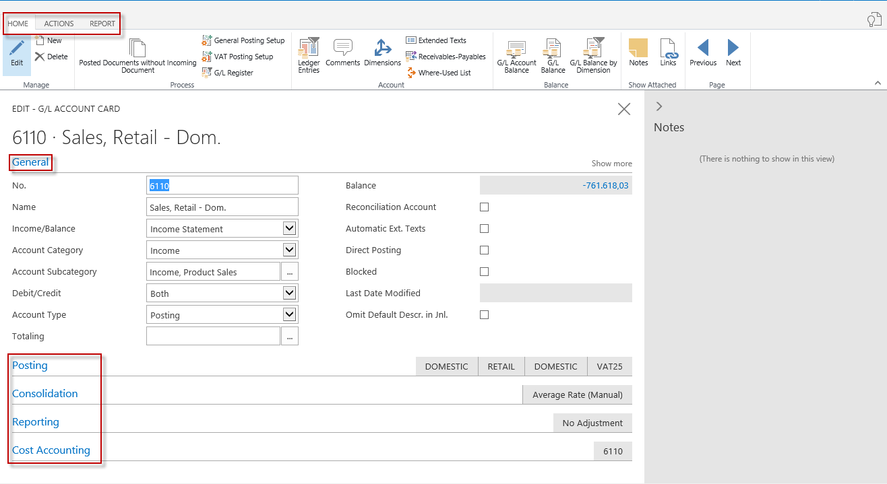
G/L Account Card
Ribbon Tabs
Home
Actions
Report
FastTabs
General
Posting
Consolidation
Reporting
Cost Accounting
Notes:
After showing this slide, you can go to Microsfot Dynamics NAV and create a new G/L account, together with the audience.
Following FastTabs should only be covered very briefly:
Consolidation
Reporting
Cost Accounting
You can refer to other courses for these functions.

Slide 48
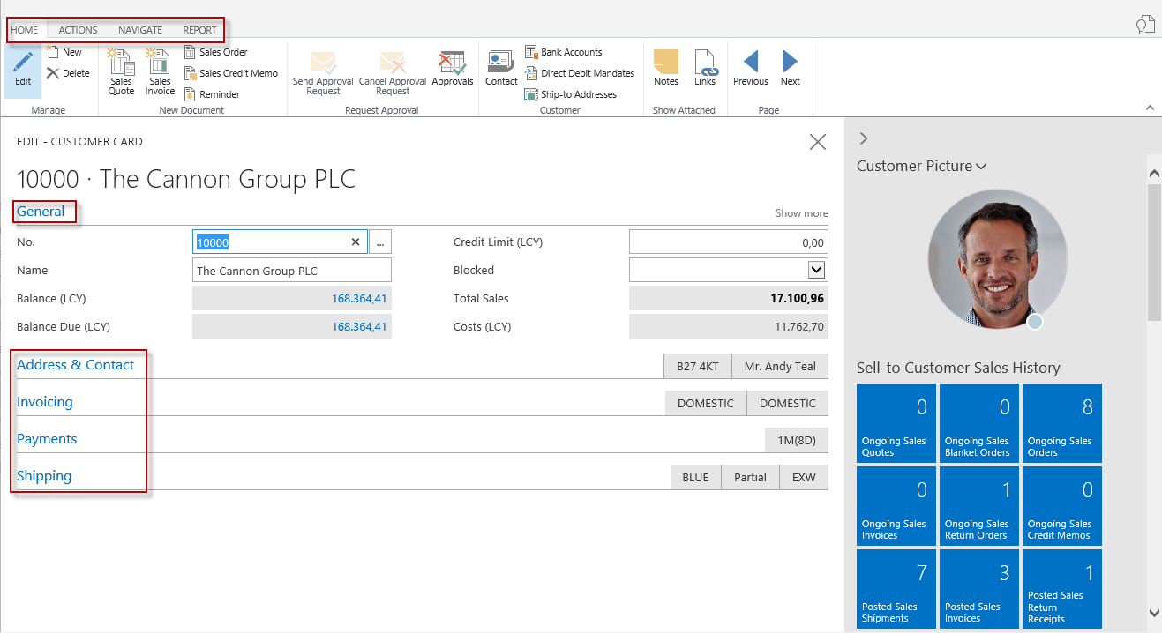
Customer Card
Ribbon Tabs
Home
Actions
Navigate
Report
FastTabs
General
Address & Contact
Invoicing
Payments
Shipping
Notes:
After showing this slide, you can go to Microsfot Dynamics NAV and create a new customer, together with the audience.

Slide 49
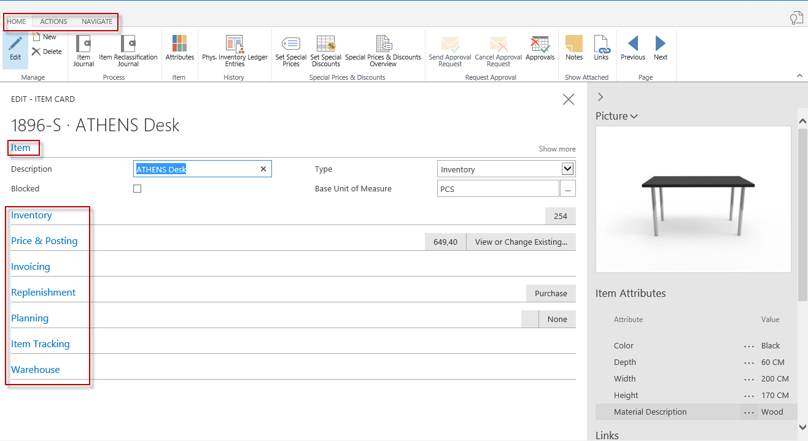
Item Card
Ribbon Tabs
Home
Actions
Navigate
FastTabs
Item
Inventory
Price & Posting
Invoicing
Replenishment
Planning
Item Tracking
Warehouse
Notes:
After showing this slide, you can go to Microsfot Dynamics NAV and create a new customer, together with the audience.
An item card has many fields, integrating with other modules.
After covering the basics, briefly hightlight other important functions (such as item tracking, warehousing, …) but refer to other courses for more information.

Slide 50
Item Attributes
Item characteristics: year, color, material, …
Customer inquiries
Web shop search
Value types: Option, Text, Integer, Decimal
Translations
Notes:
After showing this overview of the different field types, you might want to demonstrate the following:
Shortcuts for dates in date fields
Calculations in number fields
DrillDown of FlowFields

Slide 51
Master Data for the Sales and Purchase Process - Review
G/L Account Cards
Chart of Accounts Page
Customer Cards
Vendor Cards
Item Cards

Slide 52
Module 8
Process Sales and Purchases

Slide 53
Process Sales and Purchases - Overview
Process Flows
From Purchase Order to Purchase Invoice
Create Purchase Invoices
From Sales Quote to Sales Invoice
Notes:
After a general module overview, ask the students how sales and purchases processes could look like.
Alternatively, you could have some students draw sales/purchase diagrams on the whiteboard/flipchart.
That could be the perfect introduction to the following lesson.

Slide 54
Process Flows – Purchase Process
Purchases and Payables
Create a Purchase Order
Inventory
Post the Receipt
Posted Receipt
Update Item
Update the Vendor Card
Post the Invoice
Posted Invoice
Update Chart of Accounts
General Ledger
Issue Payment
Notes:
Use this diagram to explain how a standard purchase process could look like in NAV.
Mention that purchase orders can be created manually, but also automatically from preceding documents. You could ask the audience which ones.

Slide 55
Process Flows – Sales Process
Sales and Receivables
Enter a Sales Quote
Convert to an Order
Inventory
Post the Shipment
Posted Shipment
Update Item
General Ledger
Update the Customer Card
Post the Invoice
Posted Invoice
Update Chart of Accounts
Record Customer Payment
Notes:
Use this diagram to explain how a standard sales process could look like in NAV.
After showing these diagrams, you can start creating and processing purchases and sales in NAV.
You could use following flow:
Create a Purchase Order
Process a Purchase Order
Practice: Purchase Furniture from a Vendor
Create Purchase Invoices Using the Get Receipt Lines
Create a Sales Quote
Convert the Quote to a Sales Order
Process the Sales Order
Set Up Document Sending Profiles
Assign Document Sending Profiles to Customers
Email an Invoice to a Customer
Practice: Sell Wooden Doors to an Existing Customer

Slide 56
Process Sales and Purchases - Review
Process Flows
From Purchase Order to Purchase Invoice
Create Purchase Invoices
From Sales Quote to Sales Invoice

Slide 57
Module 9
Technology Overview

Slide 58
Technology Overview - Overview
Microsoft Dynamics NAV Development Environment
Web Services Support
Multilanguage Functionality
Notes:
The purpose of this module is to highlight some important technical features and concepts in Microsoft Dynamics NAV.
When covering the module overview, mention that there are technical courses for student that have the ambition of becoming a NAV technical consultant or developer.

Slide 59
Microsoft Dynamics NAV Development Environment
Object Designer
Application Objects
Other Uses:
Databases
Debugger
NAV licenses
Notes:
Atlhough business users will typically not use the Development Environment, for technical users and application consultants, it’s very important.
Give brief overview of the different object types, and then explain the other uses as listed on this slide.

Slide 60
Web Services
Enable applications to communicate with one another
Create and publish Microsoft Dynamics NAV 2017 data and functionality as a web service
SOAP web services
OData web services
Notes:
Besided explaining “what” a web service is, it’s also important that the audience understands when/why to use webservices and what the benefits could be.
You could demonstrate this by showing the standard function in Microsoft Dynamics NAV 2016 to update the currency exchange rates by using a web service.

Slide 61
Technology Overview - Review
Microsoft Dynamics NAV Development Environment
Web Services Support
Multilanguage Functionality

